Slide 1
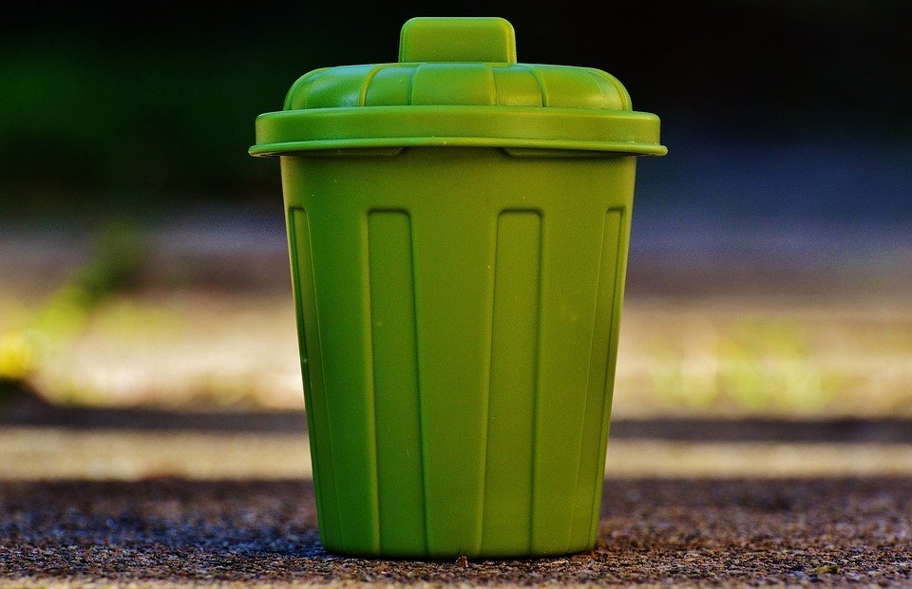
Development of Smart Waste Management System based on IoT platform

Slide 2


Mini Project By:
SHIVA SAI(18BEC012)
KIRAN D(18BEC022)
NIKHIL S A(18BEC033)
NITHIN R(18BEC034)
Project Guide:
Dr. Prakash Pawar

Slide 3

PROBLEM STATEMENT:
The main problems of the existing solid waste collection process and management system are as follows.
1.Lack of the information about the collecting time and area.
2.Lack of the proper system for monitoring, tracking the trucks and trash bins that have been collected in real time.
3.One of the main concerns with our environment has been solid waste management which impacts the health and environment of our society.
4.There is no quick response to urgent cases like truck accident, breakdown, longtime idling.
5.There is no quick way to response to client's complaints about uncollected waste.

Slide 4
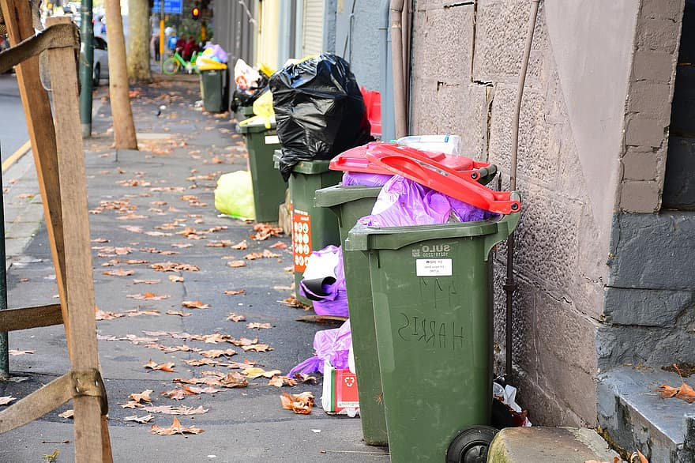
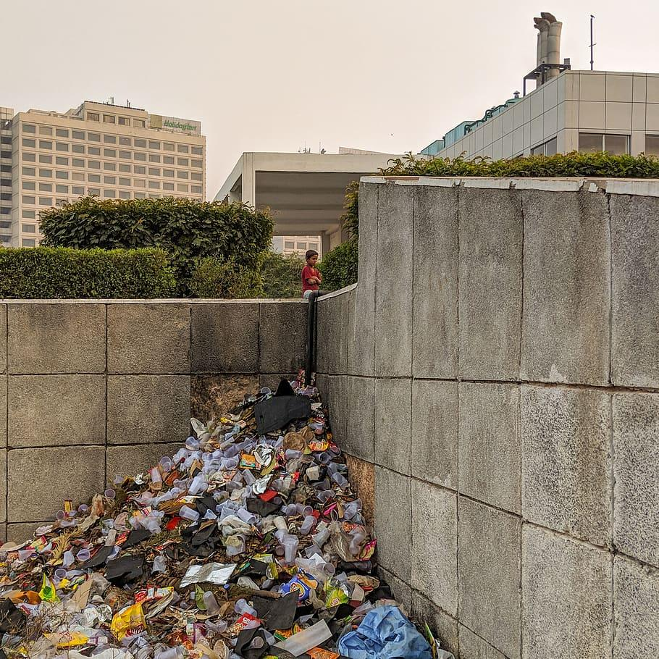
Examples:

Slide 5

EFFECTS OF IMPROPER RUBBISH REMOVAL AND WASTE MANAGEMENT
Soil contamination.
Air contamination.
Water contamination.
Bad impact on human health.
Impact on animals.
Disease-carrying pests.
Missed recycle opportunity.
It is slowly killing planet.
Causes extreme climatic changes.

Slide 6

SOLUTION:
What our system does is it gives a real time indicator of the garbage level in a trash-can at any given time.
Using that data we can then optimize waste collection routes and ultimately reduce fuel consumption. It allows trash collectors to plan their daily/weekly pick up schedule.
We can implement our project in our brand new campus to maintain cleanliness and hygiene.

Slide 7
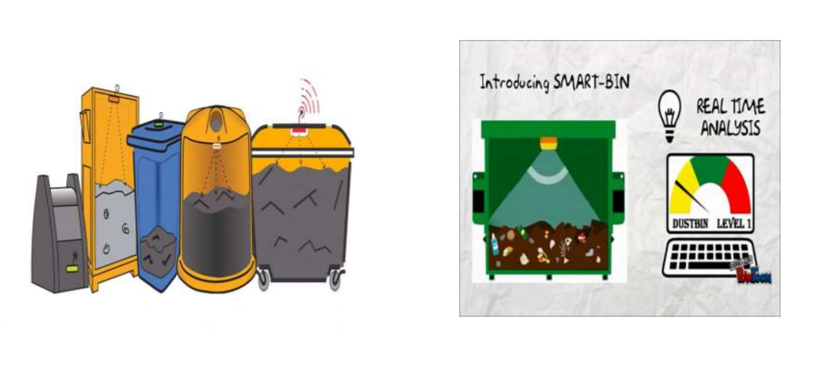

Slide 8
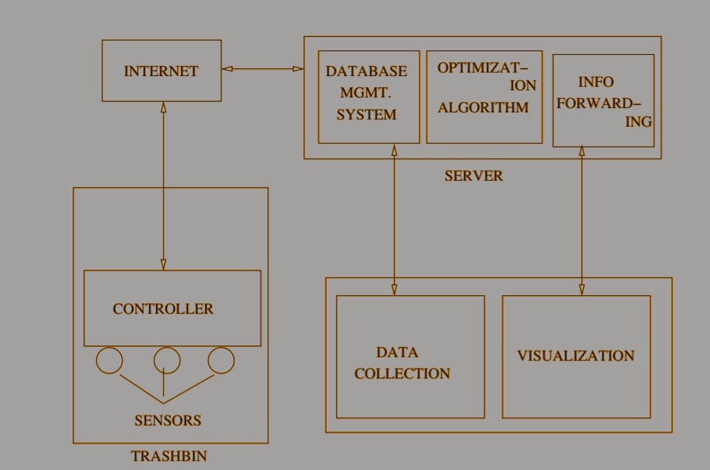
S
Y
S
T
E
M
A
R
C
H
I
T
E
C
T
U
R
E

Slide 9
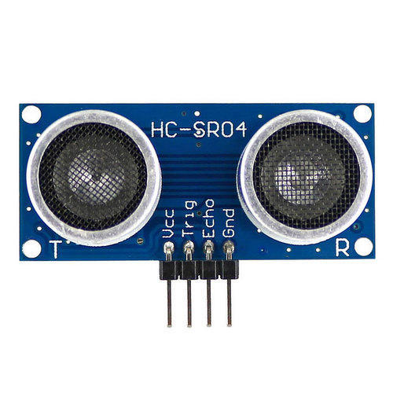
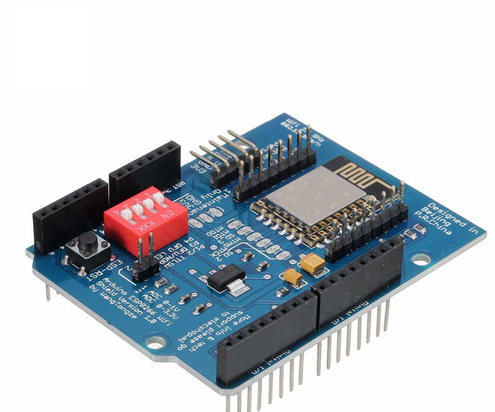
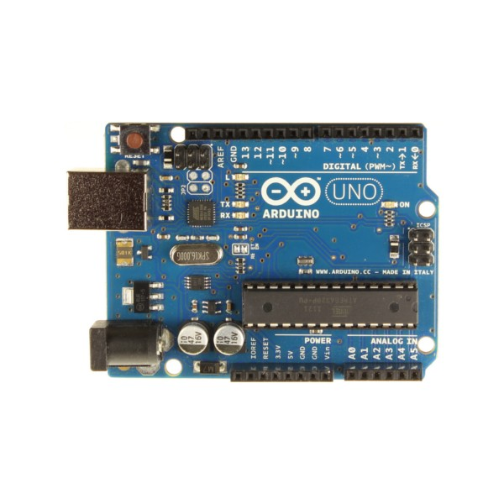
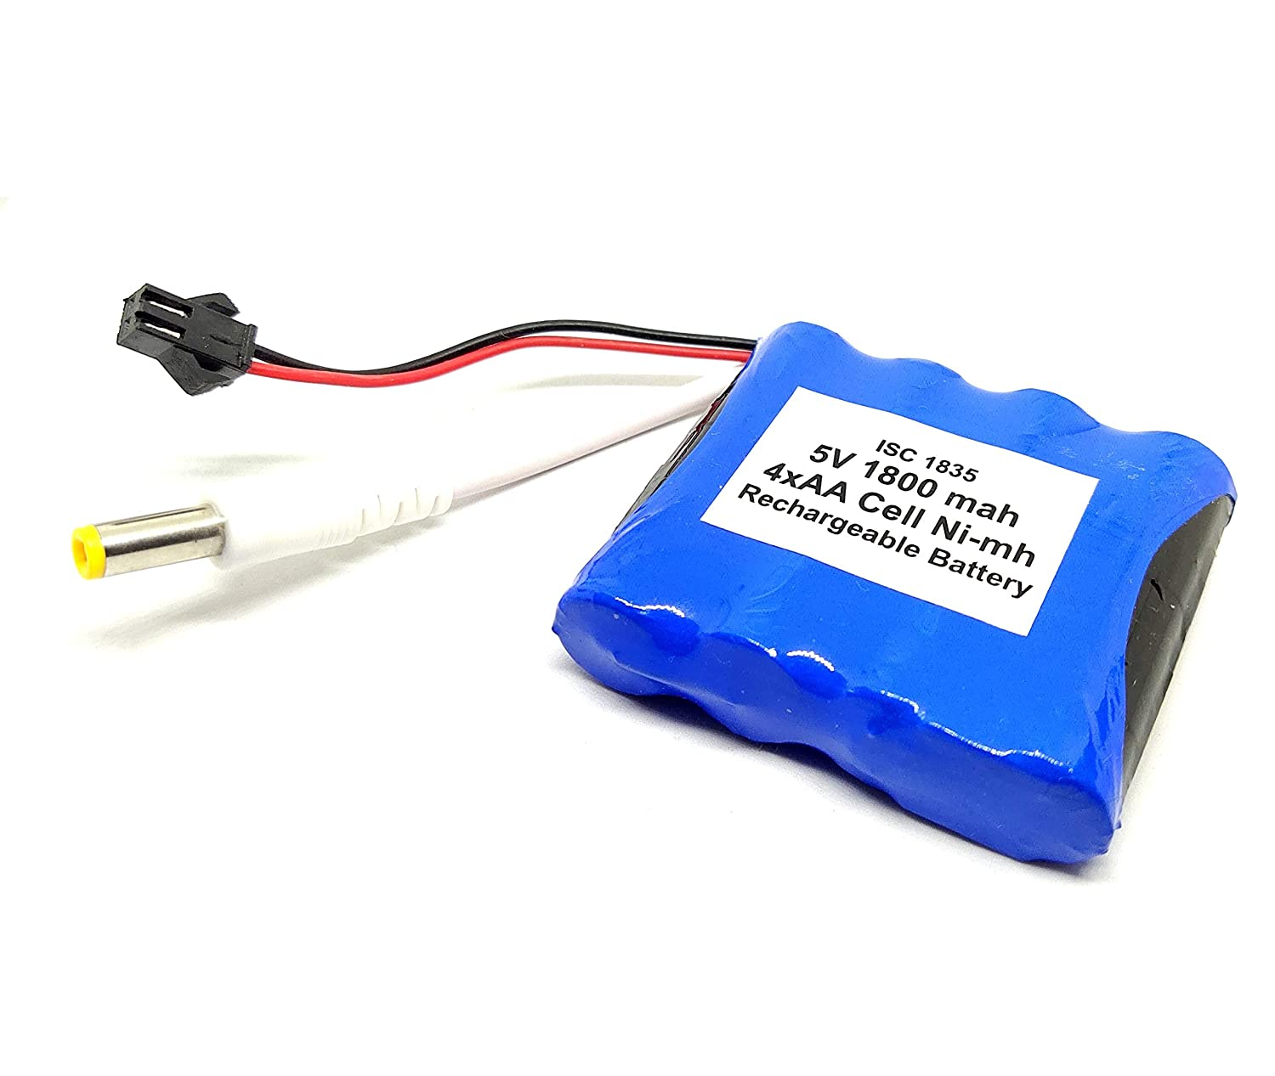
Components Required for designing:
1)Ultrasonic sensor 3)Wifi Shield
2)Arduino uno 4)Battery.

Slide 10
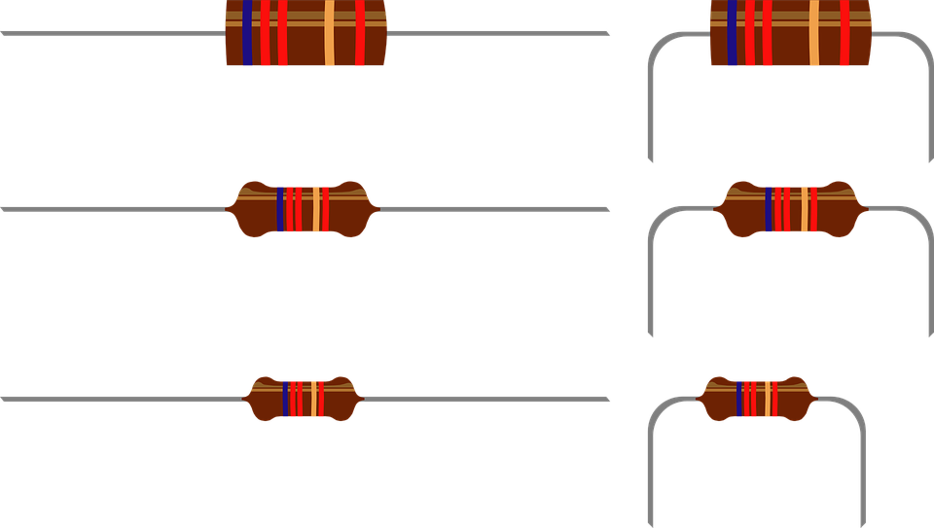
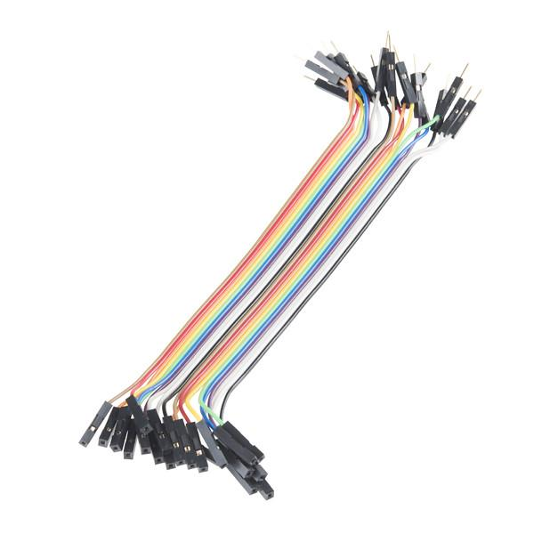

Components Required for designing:
4)Resistors 5)Jumper wires
Software Required:
Arduino IDE

Slide 11
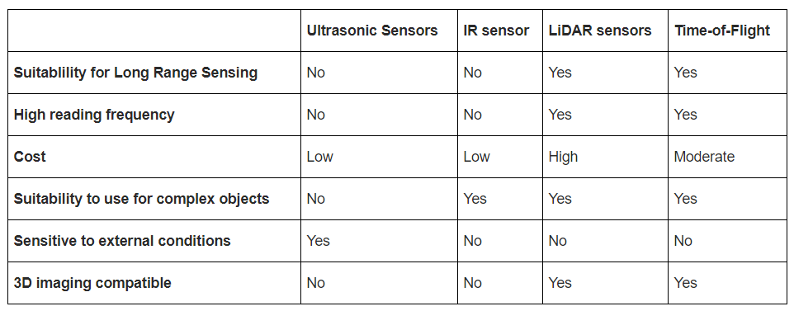
Distance measuring sensors:

Slide 12
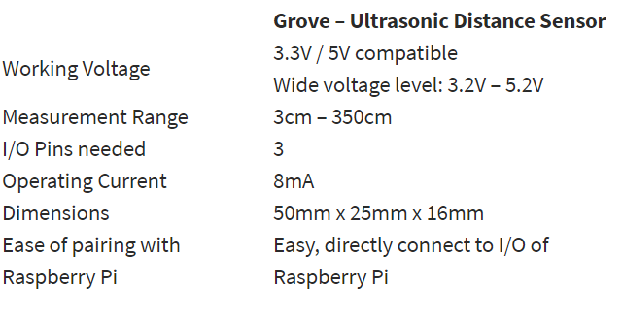
Reason for selecting Ultrasonic Sensor:
The ultrasonic sensor emits high-frequency sound waves towards the target object. Target object picks up the sound waves Sound waves are then bounced off and reflected back towards the ultrasonic sensor. The time it took for the sound wave to return is used as the measurement of the distance between.
Not affected by object colour and
transparency as it detects distance
through sound waves.
Works well in places that are dim.
Tend to consume lower current/power.
Multiple interface options for pairing
with a microcontroller, etc.

Slide 13
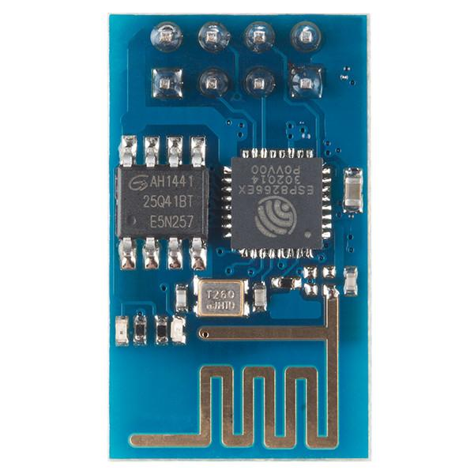
ESP8266 WIFI Wireless Transceiver Module:
The ESP8266 WiFi Module is a self contained SOC with integrated TCP/IP protocol stack that can give any microcontroller access to your WiFi network. The ESP8266 is capable of either hosting an application or offloading all WiFi networking functions from another application processor. Each ESP8266 module comes pre-programmed with an AT command set firmware, meaning, you can simply hook this up to your Arduino device and get about as much WiFi-ability as a WiFi Shield offers (and that's just out of the box)! The ESP8266 module is an extremely cost effective board with a huge, and ever growing, community.

Slide 14

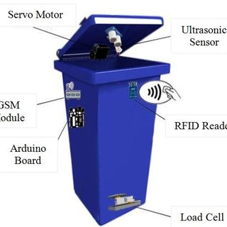
An ultrasonic sensor will be placed on the interior side of the lid, the one facing the solid waste. As trash increases, the distance between the ultrasonic and the trash decreases. This live data will be sent to our microcontroller.

Slide 15
Algorithm for large-scale implementation:
1: Install several waste-bins at multiple locations in the city;
2: Embed each of waste-bins with IoT devices;
3: Define threshold value for wastes for each of the waste-bins;
4: Collect the wastes in the waste-bins;
5: Send the collected data(using smart waste-bins algorithm) over the Internet to the servers;
6: Store and process the information in the server;
7: Calculate and send the optimized routes to send the vehicles for waste collection(using SP algorithm);
8: Empty the wastes from the identified waste-bins;
9: Use the collected data for monitoring daily selection of waste-bins;
10: Predict future traffic in specific location as per Server(future prediction)algorithm

Slide 16
Smart waste-bins Algorithm:
1: Sense the level of wastes in waste-bins every 2 hour during the weekday ;
2: Sense the level of wastes in waste-bins every 1 hour during the weekend ;
3: Compute the rate at which waste-bins is getting field ;
4: If the waste-bins level is more than 70% then send the message to the server to send the vehicle for waste collection;
5: If the waste-bins level is below 70% then send the message to the server, not to send the vehicle for waste collection

Slide 17
Shortest Path Algorithm:
1: Consider street network as a graph;
2: Consider street segments as edges and joining points as vertices;
3: Calculate an accurate shortest travelling distance between two locations;
4: Calculate the distance from one-to-all waste-bins to speed up the route optimization process;

Slide 18
Server(future prediction) Algorithm:
1: Get waste level for every day of the week from all waste-bins ;
2: Observe the changes in the waste levels during the week-days and weekends;
3: Note down the drastic changes during the specific days;
4: Calculate the distance to waste-bins which have significant rise in waste levels;
5: Speed up the route optimization process for those days;
6: If the rate fill of waste-bins in given area is very high, send alert to municipality to increase vehicles & waste-bins;

